Slide 1

ECE 4099 : Capstone Project [Review – 3]
CAN Data Logger for X-Ray Collimator
Internal Guide
Dr. Sofana Reka S
SENSE, VIT – Chennai
External Guide
Ms. Shamlin Sunny (SHS TI TC ITT)
Technology Head ITT India
Presented By:
K Manoj Madhav
15BEC1078

Slide 2
OBJECTIVE
To log CAN Data from Imaging Equipment to remote view any issue avoiding the need for physical intervention.
CAN Protocol issues at present viewed using CAN Analyzer.
Continuous Data Logging from X-Ray Collimator.
Dosimeter data acquisition.
Visualization of Acquired Data.

Slide 3

PROJECT TIMELINE :
Introduction to various Siemens Diagnostic/Imaging Equipment
Workflow pain-points (Disadvantages) in various departments
Description of the technologies used (Comm. Protocols)
Proprietary Materials and White-Papers to study
Identification of problem w.r.t equipment/workflow
Stage 1 (Introduction) Jan ‘19 – Feb ’19
Problem discussion with concerned team (AT– Advanced Therapy)
Solution concept brainstorming - Mr. Pradeep P A (R&D –AT)
Obtaining of CAN Data in Linux/QNX system
Check hardware compatibility (with existing collimators)
Troubleshoot Errors
Final demonstration of Proof Of Concept to Mr. Mathew Abraham
Stage 2 (Pre-Implementation) Feb ‘19 – Mar ’19
Stage 3 (Implementation) Feb ‘19 – Mar ’19
Check feasibility of implementation (Retrofitability)
Send proposal to R&D Erlangen (Germany)
Documentation & Archiving
Stage 4 (Documentation) Apr ‘19 – May ’19

Slide 4

INITIAL SOLUTION
Current CAN Analyzer used to monitor high-speed can networks :
Microchip APGDT002
Internal Major Components of APGDT002:
MAX 3378E – Level Translator (for Multi-Voltage Systems)
MCP 2551 – High-Speed CAN Transceiver
PIC 18F2680 – µC receiving serial data from CAN Transceiver; Alternating CAN Data w.r.t to trigger signals given as input
PIC 18F2550 – µC controlling internal status lights

Slide 5
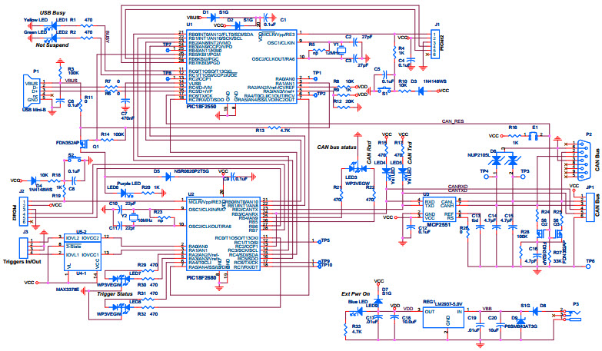
SOLUTION ANALYSIS
Async. serial comm. of CAN Data to µCs via (USB to I2C)
8-bit to USB Parallel Converter

Slide 6
SOLUTION REJECTED, WHY?
Cost of Implementation of this CANalyzer is very high. (~ $65 per Machine).
Models launched before the Artis System do not support this hardware addition.
External input for CAN-Bus response has to be provided.
Licensing issues when utilizing the CANalyzer on a vast scale.
Not an immediate solution to the problem.

Slide 7
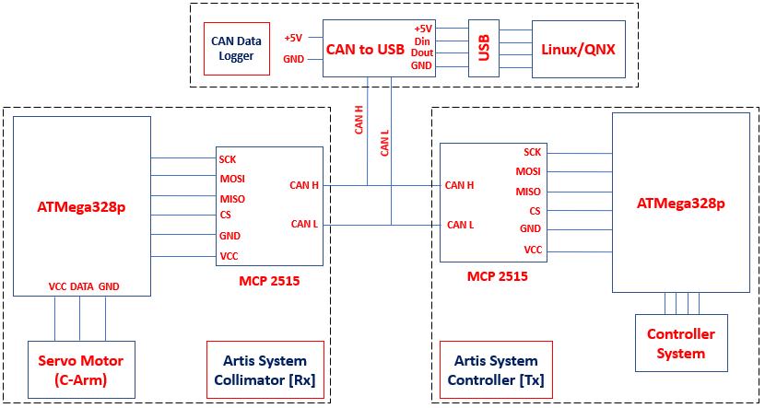
VIABLE SOLUTION

Slide 8
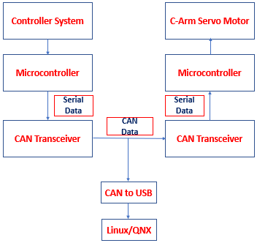
VIABLE SOLUTION

Slide 9
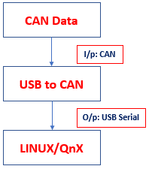
VIABLE SOLUTION
The CAN Data being pulled out from the CAN Bus line is fed into a USB to CAN Converter.
This Data is now available in USB Data format that is transmitted serially to the next visualization platform.
This visualization of data is possible because the data received is in the form of USB Serial Data.
Extraction of Data Packets In Artis System
– (Proposed Idea)

Slide 10
ARTIS SYSTEM: CONTROLLER [Tx]
The serial data signal from the controller system is converted to CAN Data by the internal CAN Transceiver.
This Data is now transmitted to the Collimator Control Panel for the reception.
A Standard DB9 (RS232) Connection is used to connect the Controller and the Collimator.
IMAGE REMOVED IN ACCORDANCE TO SIEMENS COMPLIANCE POLICY.
CANBUS Line from Controller [Tx] – Collimator [Rx]

Slide 11
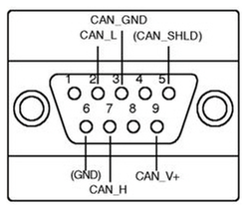
ARTIS SYSTEM: CONTROLLER [Tx]
IMAGE REMOVED IN ACCORDANCE TO SIEMENS COMPLIANCE POLICY.
The CAN Data bitstream to be sniffed is from the X21 CAN1_OUT Port.
The data bitstream is not manipulated or tampered with as there is a parallel connection split out for the tapping purposes.

Slide 12
ARTIS SYSTEM: COLLIMATOR [Rx]
Collimator[Rx] Control Unit
The CANBUS line X21 CAN1_OUT from the collimator is plugged into the Collimator Control Unit.
This Data is now again converted back in to serial data by the internal transceiver present at the collimator logic board.
This serial data is sent to various subsystems present i.e., C-Arm Servos and X-Ray Generators.
IMAGE REMOVED IN ACCORDANCE TO SIEMENS COMPLIANCE POLICY.
X-Ray Generator

Slide 13
ARTIS SYSTEM: COLLIMATOR [Rx]
IMAGE REMOVED IN ACCORDANCE TO SIEMENS COMPLIANCE POLICY.
IMAGE REMOVED IN ACCORDANCE TO SIEMENS COMPLIANCE POLICY.
X21 CAN1_IN Line from Tx
Internal µC of Collimator
X21 CAN1_OUT CANBUS line from the controller is plugged into the Collimator Unit.
Multiple CANBUS lines are plugged into the collimator for multiple signal input.
Internal CAN Transceivers convert the CAN Data to Serial Data.
Internal Microcontroller transmits out signals to other multiple subsytems.

Slide 14
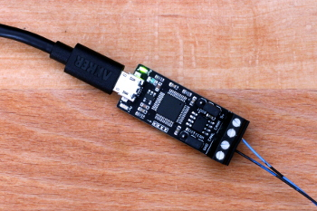
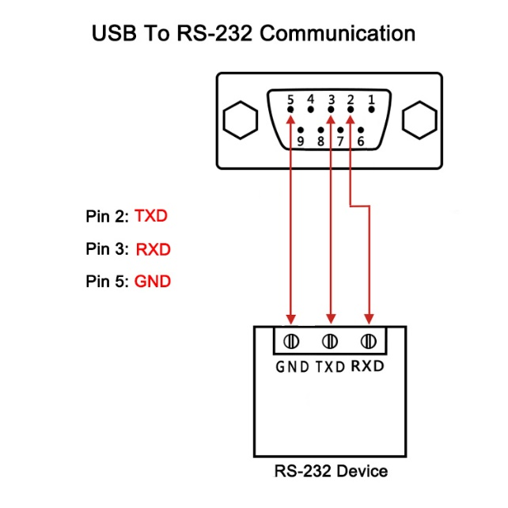
CAN → USB Converter
The CAN Data being pulled out from the CAN Bus line is fed into a USB to CAN Converter.
This Data is now available in USB Data format that is transmitted serially to the next visualization platform.
This visualization of data is possible because the data received is in the form of USB Serial Data.
CAN to USB Connection are standard through DB9 Connectors.

Slide 15
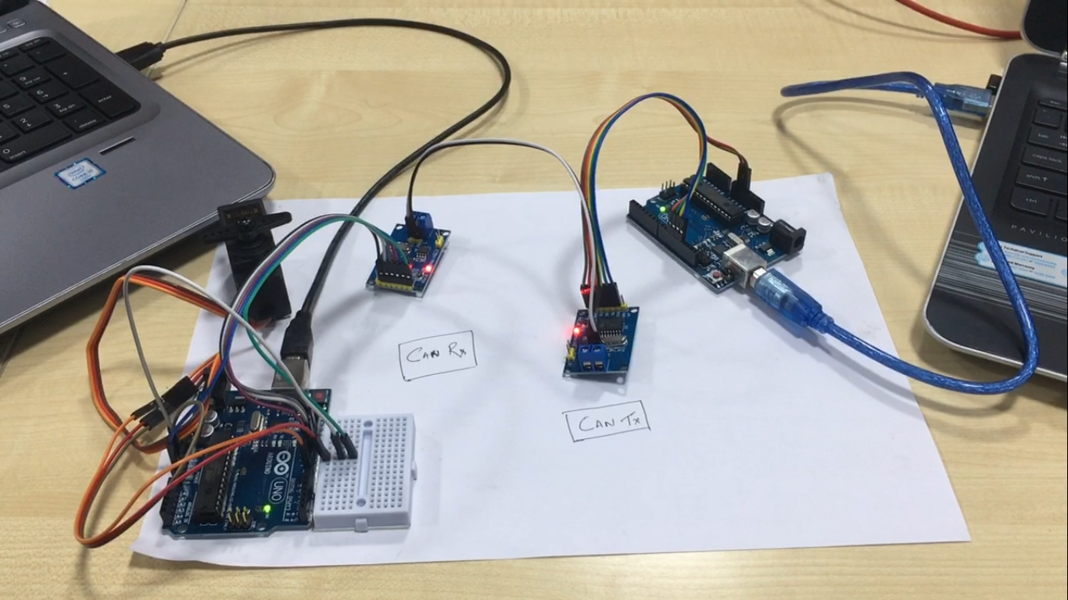
ARTIS SYSTEM REPLICA : Using MCP2515
Collimator Side:
Consists of a CAN Transceiver (MCP 2515) receiving the CAN Data Signals and converting it to Serial Data for the ATMega328p to control the servos.
Controller Side:
Consisting of a microcontroller controlled by a host system and a CAN Transceiver (MCP 2515) to convert Serial Data to CAN Data.

Slide 16
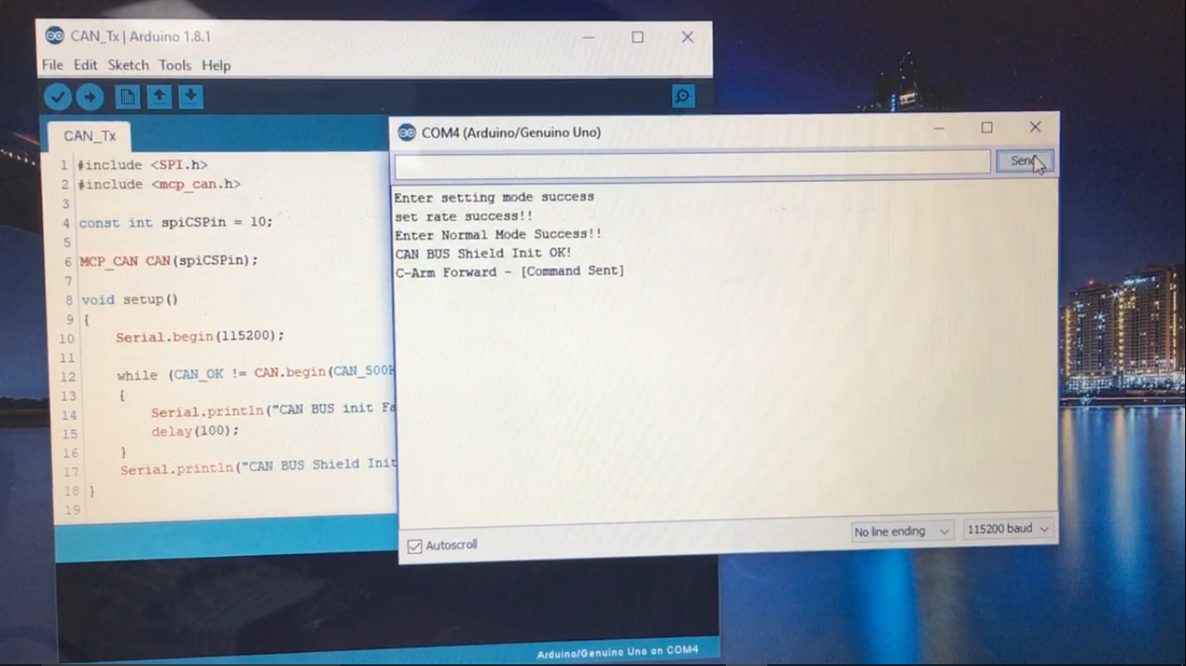
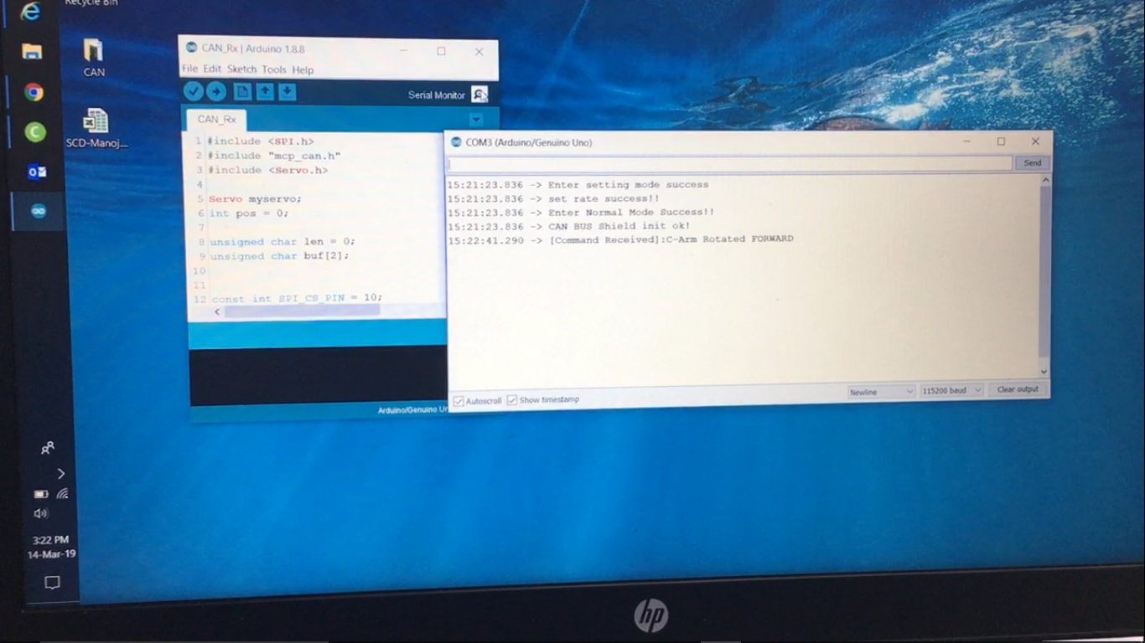
ARTIS SYSTEM REPLICA : Tx & Rx
Successful Initialisation of CAN Comm. At Tx
Keying in Command for servo motor control serially to transmit data bitstream over the CANBUS Line.
Successful Initialisation of CAN Comm. at Rx
Reception of Command for servo motor control serially transmitted by the ATMega328p microcontroller.

Slide 17
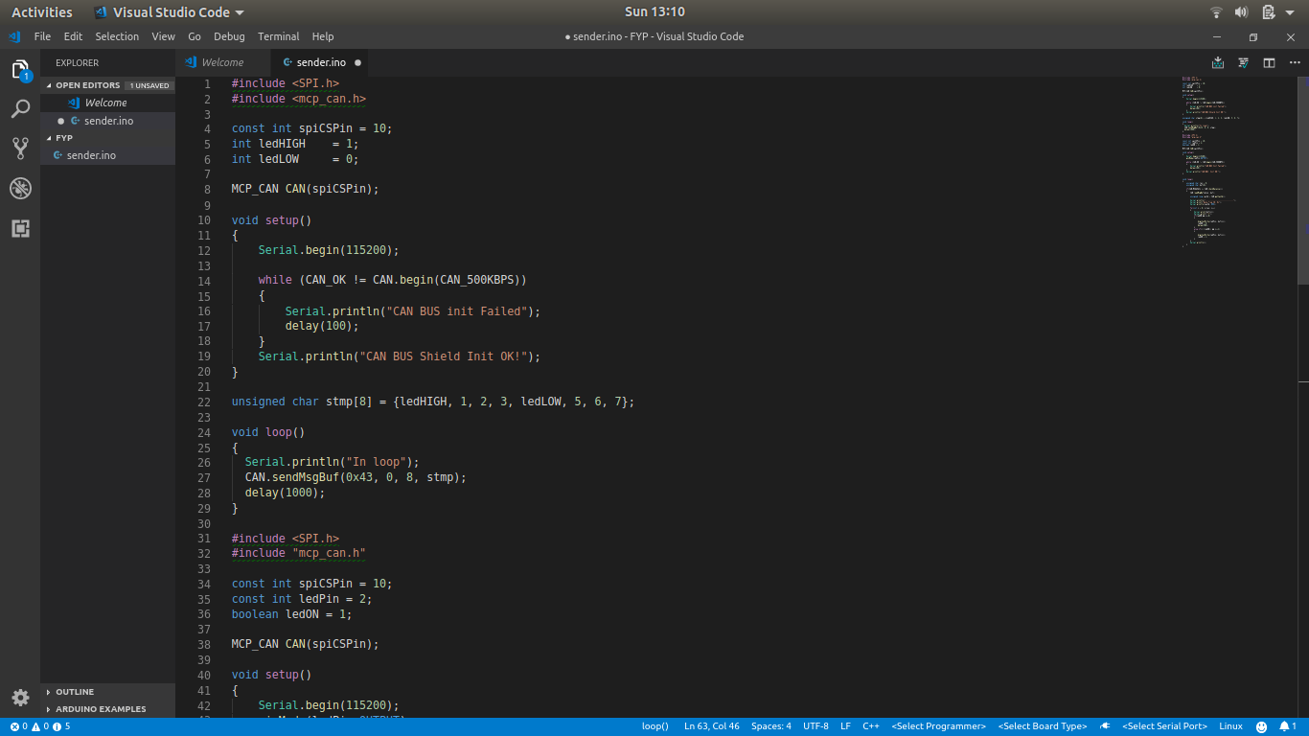
ARTIS SYSTEM REPLICA: Tx CODE

Slide 18
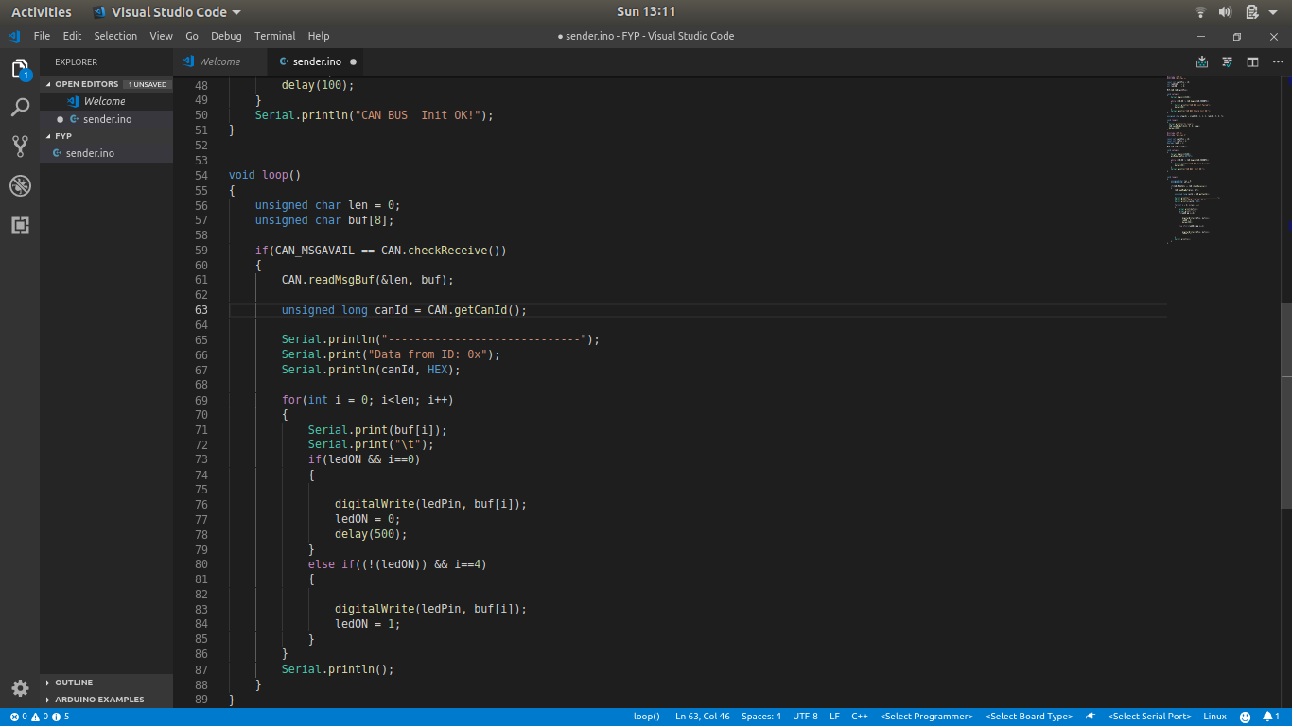
ARTIS SYSTEM REPLICA: Rx CODE

Slide 19
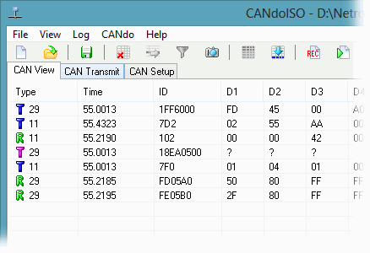
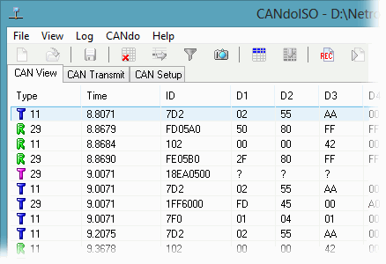
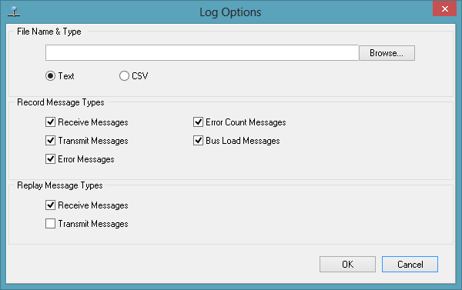
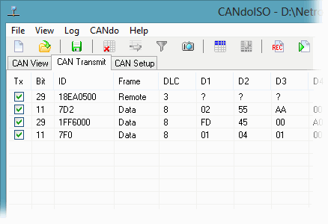
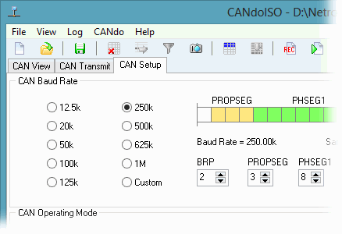
CAN DATA VISUALISATION : CANdoISO
Training on Visualization and understanding of CAN Data from X-Ray Collimator.
CAN - FIXED MODE
CAN - CYCLIC MODE
CAN - LOG
CAN - TRANSMIT
CAN - SETUP

Slide 20
REFERENCES:
An Embedded CAN-BUS Communication Module for Measurement and Control System
Xiaoming Li, Mingxiong Li, Mechatronics Institute, Faculty of Mechanical Engineering
and Automation, Zhejiang Sci-Tech University, Hangzhou, China
Embedded On-Board Diagnostics System Using CAN Protocol
Pallavi R. Burje, Kailash J. Karande, Amol B. Jagadale
Supporting Security Protocols on CAN-Based Networks
Gedare Bloom, Gianluca Cena, Ivan Cibrario Bertolotti, Tingting Hu, Adriano Valenzano
Howard University, 2300 6th St NW, Washington, DC 20059, USA
https://www.can-cia.org/can-knowledge/can/systemdesign-can-physicallayer/
https://ww1.microchip.com/downloads/en/DeviceDoc/51848B.pdf

Slide 21

Thank you

